Slide 1
AI & cybersecurity
Jackie Ocaña
MSBA 5505 – Machine Learning

Slide 2
Agenda
What is AI?
What is Cybersecurity?
The Relationship between AI and Cybersecurity
AI and Cyber Management
Summary

Slide 3
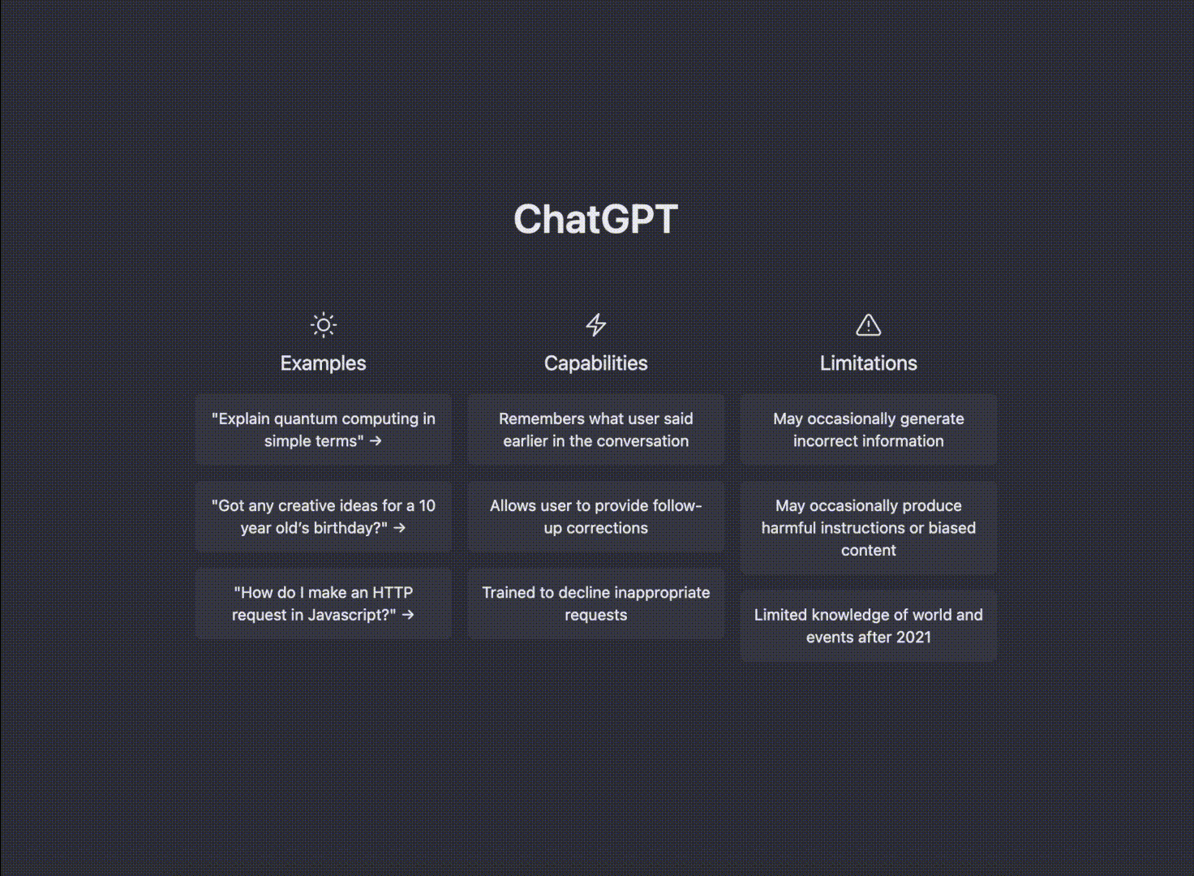
What is AI?

Slide 4
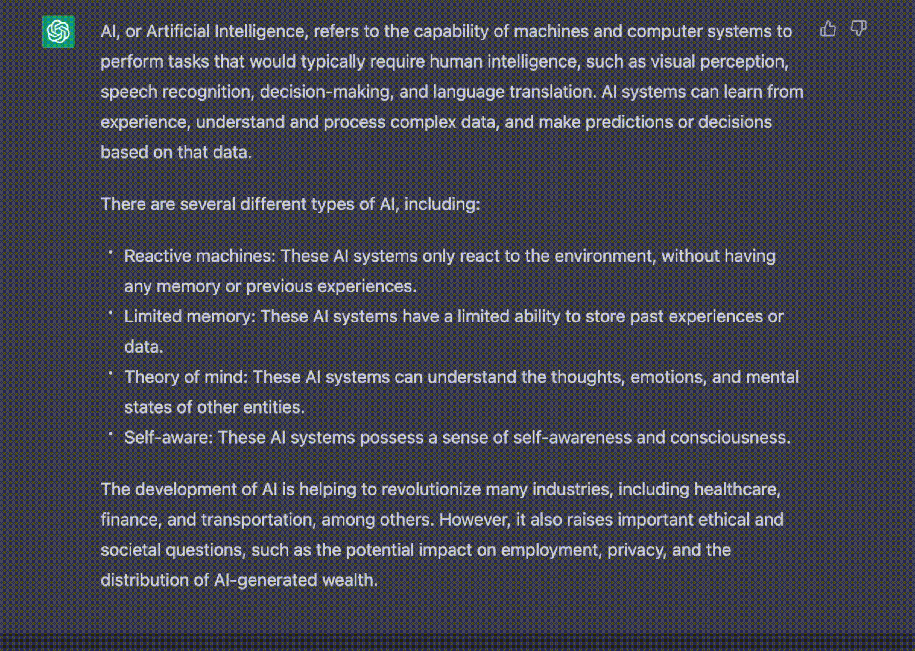
What is AI?

Slide 5
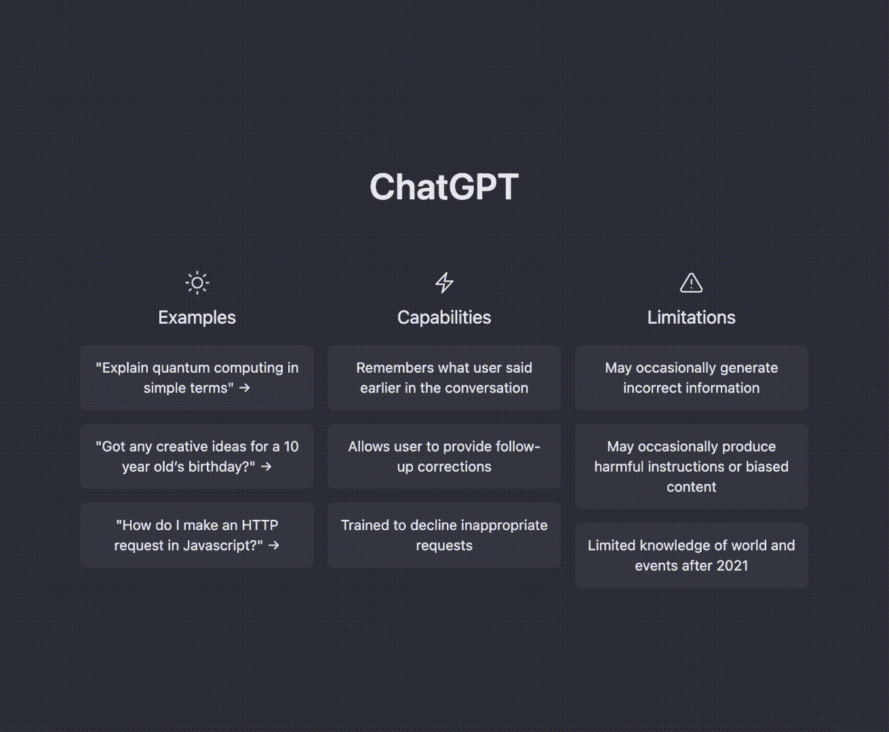
What is cybersecurity?

Slide 6
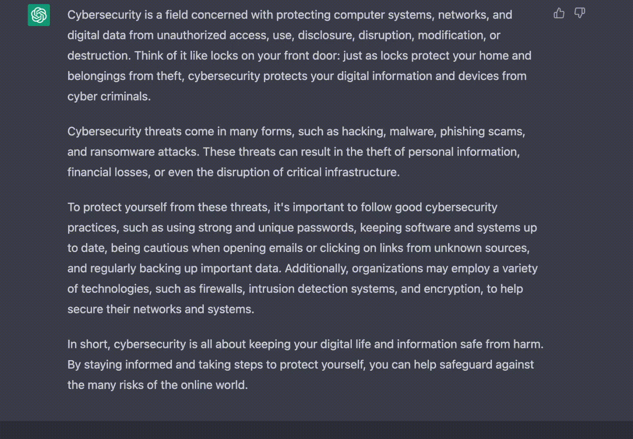
AI & Cybersecurity Relationship

Slide 7





AI & Cybersecurity Relationship
Threat Detection
Malware
Phishing
Ransomware
Firewalls
Source: Google

Slide 8

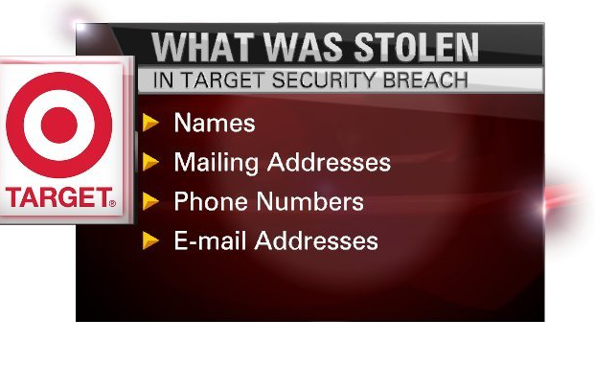
How is AI used in cyber Management
Prioritizing threats
Strategizing
Protect Data
Source: Google

Slide 9
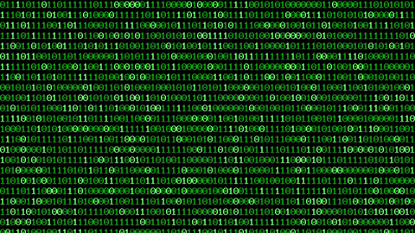
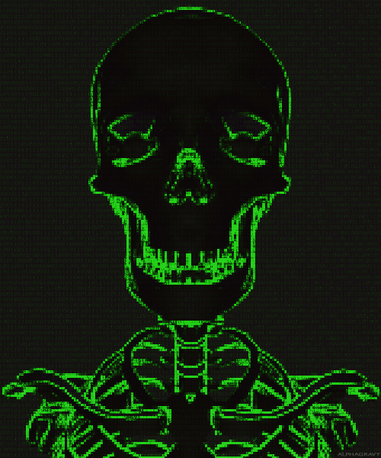
YOU HAVE BEEN HACKED

Slide 10
References
https://openai.com/blog/chatgpt/
https://www.computer.org/publications/tech-news/trends/the-impact-of-ai-on-cybersecurity
https://emeritus.org/blog/cybersecurity-ai-driven-cyber-security-companies/

